Slide 1
WELCOME TO SHASTHOSEBA
Where healing and compassion come together

Slide 2



Group Members
Taneem Ahmed
2013102042
Mahbub Morshed Rifat
2011415042
Siddhartha Sankar Saha
2011567042

Slide 3
The Roadmap
Introduction and Motivation
Benefits
Why SHASTHOSEBA is different?
Features
Implementations Description
Functional Details
Technology
Diagrams
Limitations
Future Enhancement
Project Demo
Conclusion
Question And Answer

Slide 4
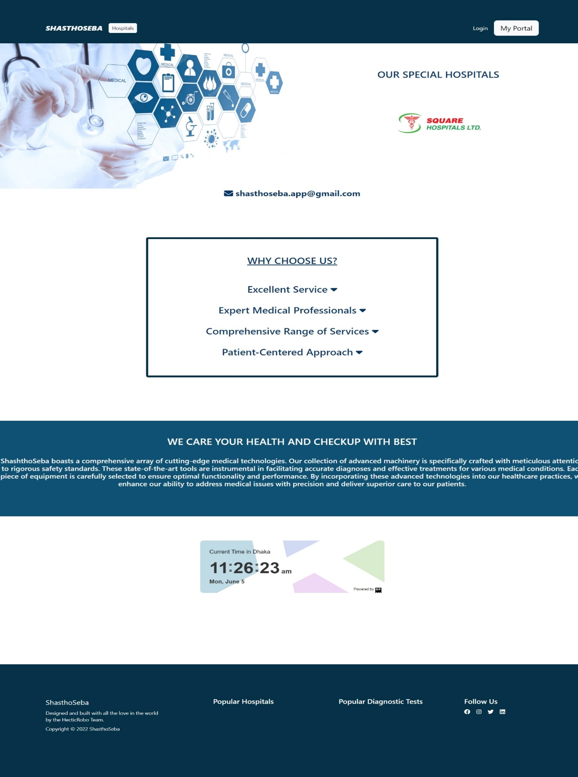
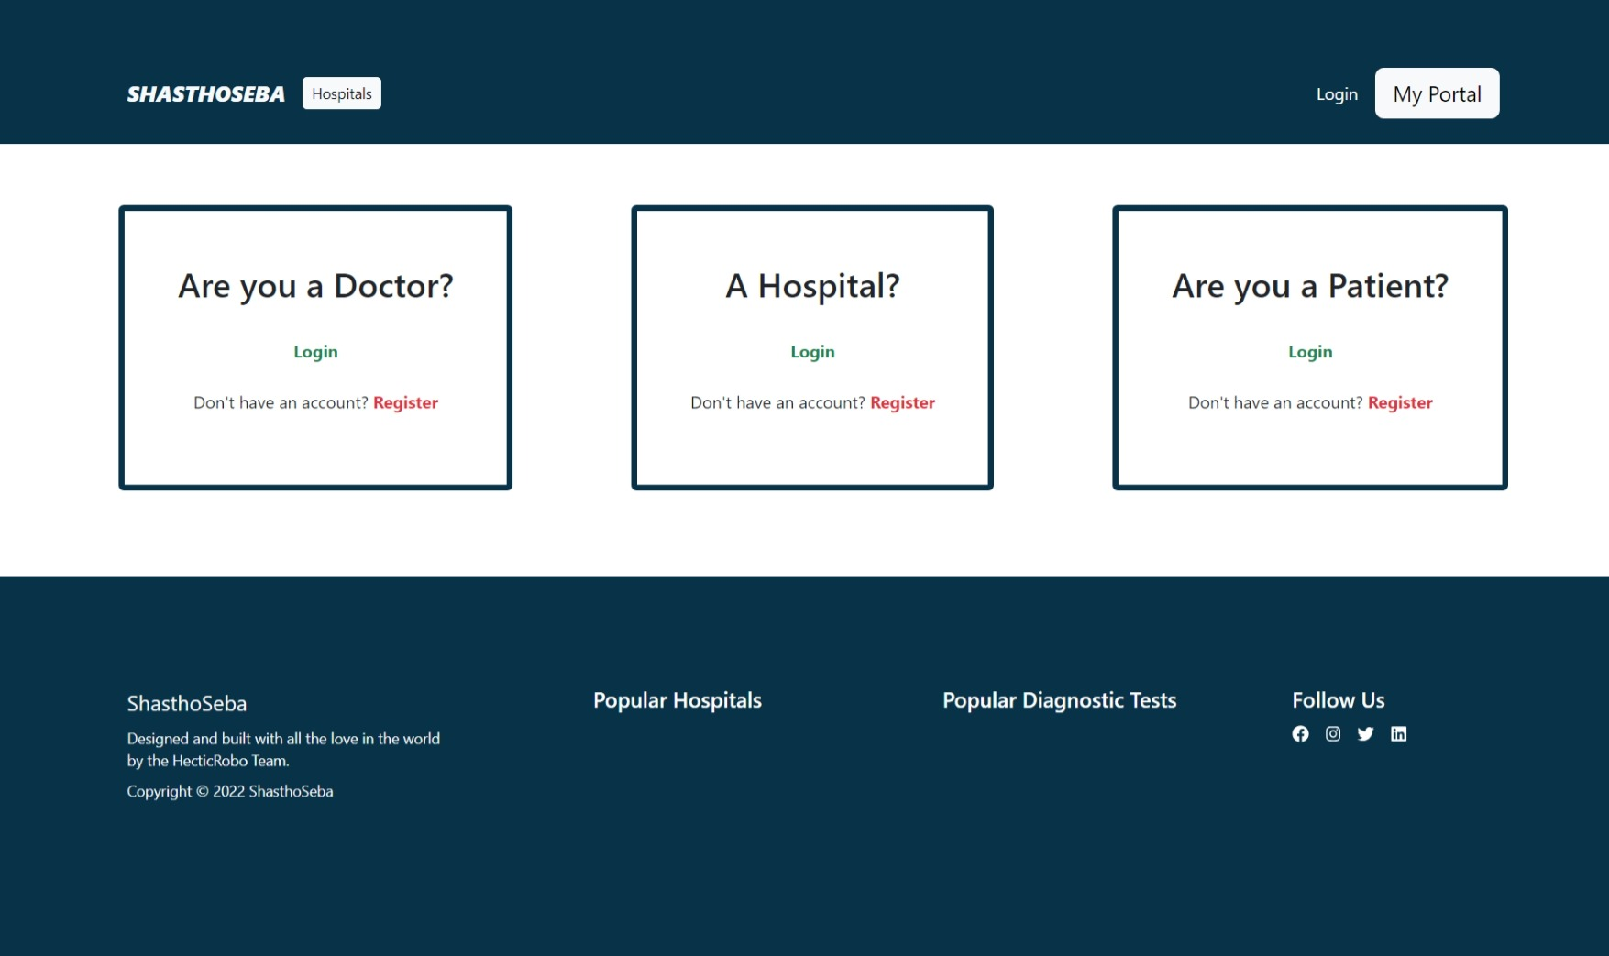
INTERFACES OF SHASTHOSEBA

Slide 5
Introduction And Motivation
Introduce to our web
Motivation of the project
SHASTHOSEBA is a centralized hospital management system.
It refers to the platform to collab all medical fields hassle-free.
Any Bangladeshi hospital or clinic can join here.
The poor condition of public hospitals
Excessive Expensive treatment in private hospitals
Lack of proper treatments
Make Healthcare a business more than a service.

Slide 6
Benefits And Existing Work
Benefits of shasthoseba
Existing works
Patients will get a centralized hospital system
Prevent Corruption
Better treatment
Help the poor people by getting cheap but well treatment
Limitations between the hospital.
No centralized system to observe.
Use their interface only for hospital purposes.

Slide 7
Features
Features mentioned in the proposal; Three types of login:
Patients:
Register
Login
Upload prescriptions
Test reports
Make an appointment
Hospitals:
Register
Login
Upload test reports
Make an appointment
Doctor’s List
Doctors:
Register
Login
Visit Appointments
Medical History

Slide 8
Implementation Description
SHASTHOSEBA will contain three portals with authentication verification. Authentication verification will be done through Gmail.
Patients Portal:
After login, the patient will be able to make an appointment. The patient will be able to upload their medical history.
Hospitals Portal:
After login, the hospital will be able to visit the doctor's list and able to visit the patient list. Also, the hospital may visit the appointments made by the patients.
Doctors Portal:
After login, the doctor visits the schedule for patients and the patient's medical history.

Slide 9
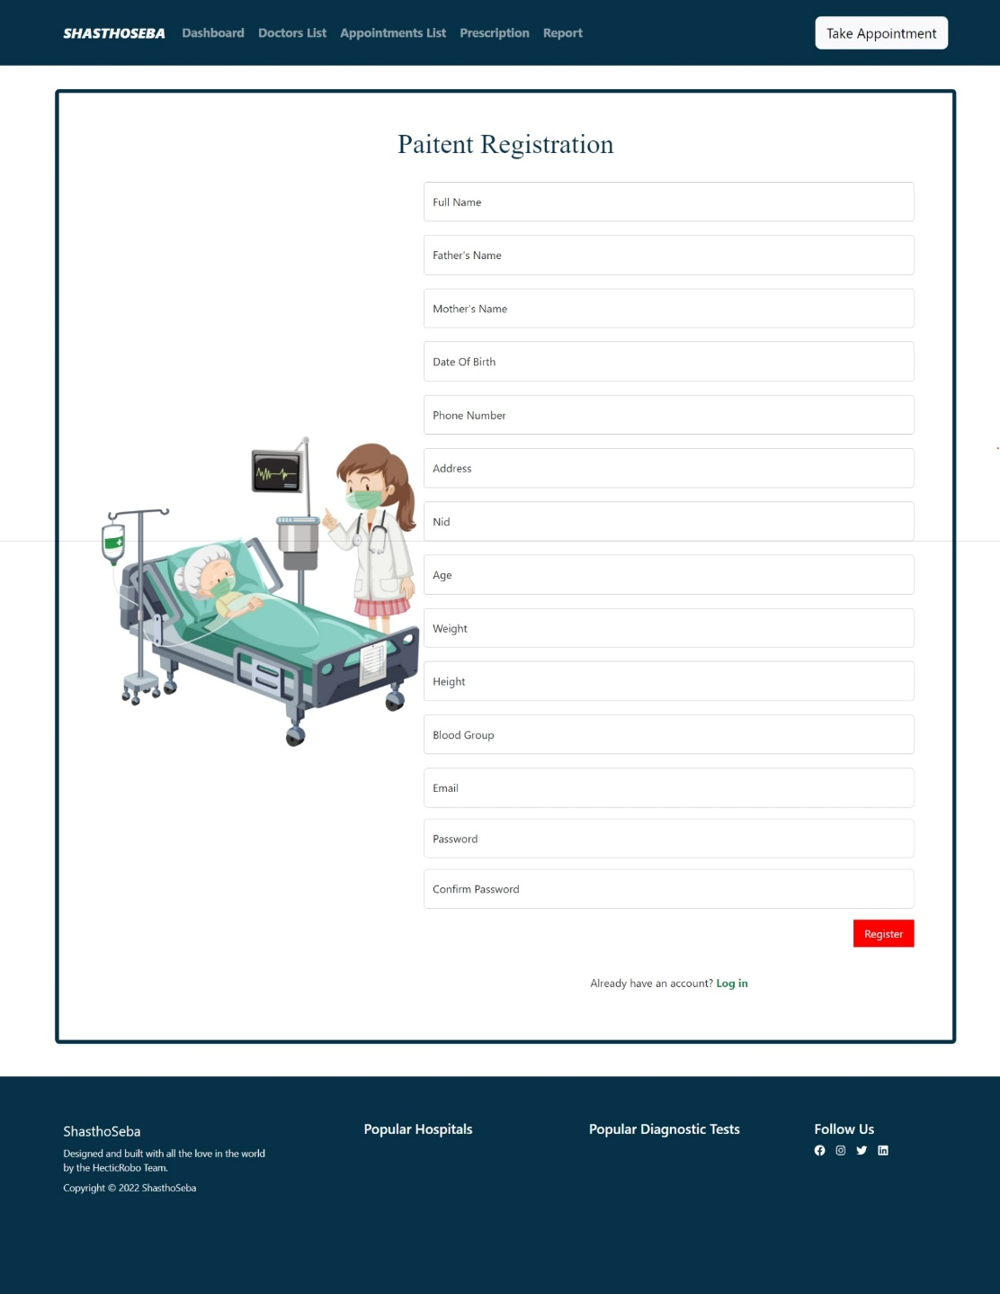
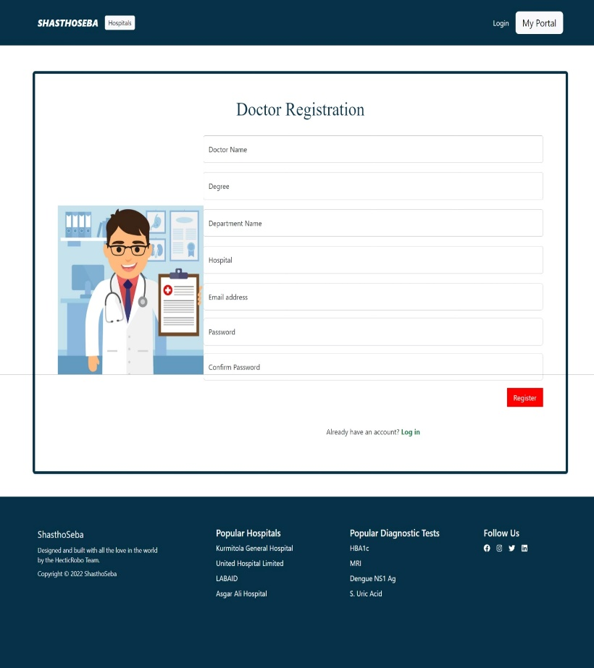
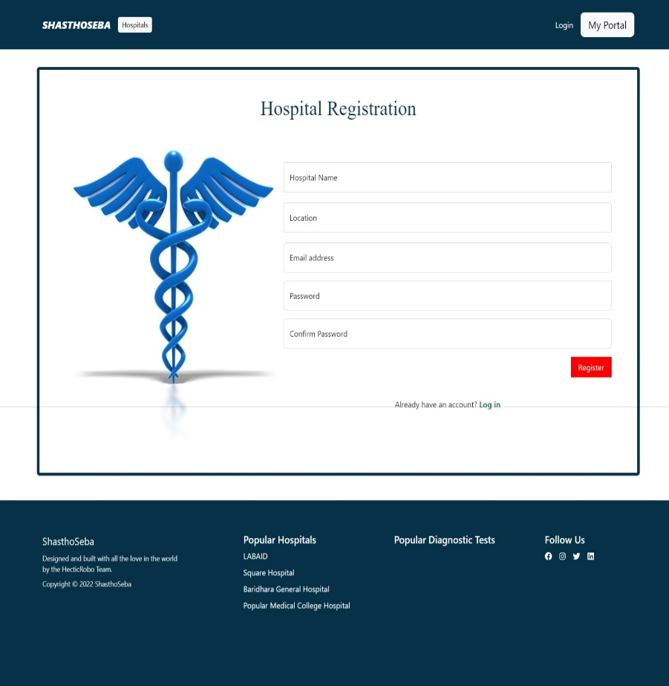
Functional Details

Slide 10
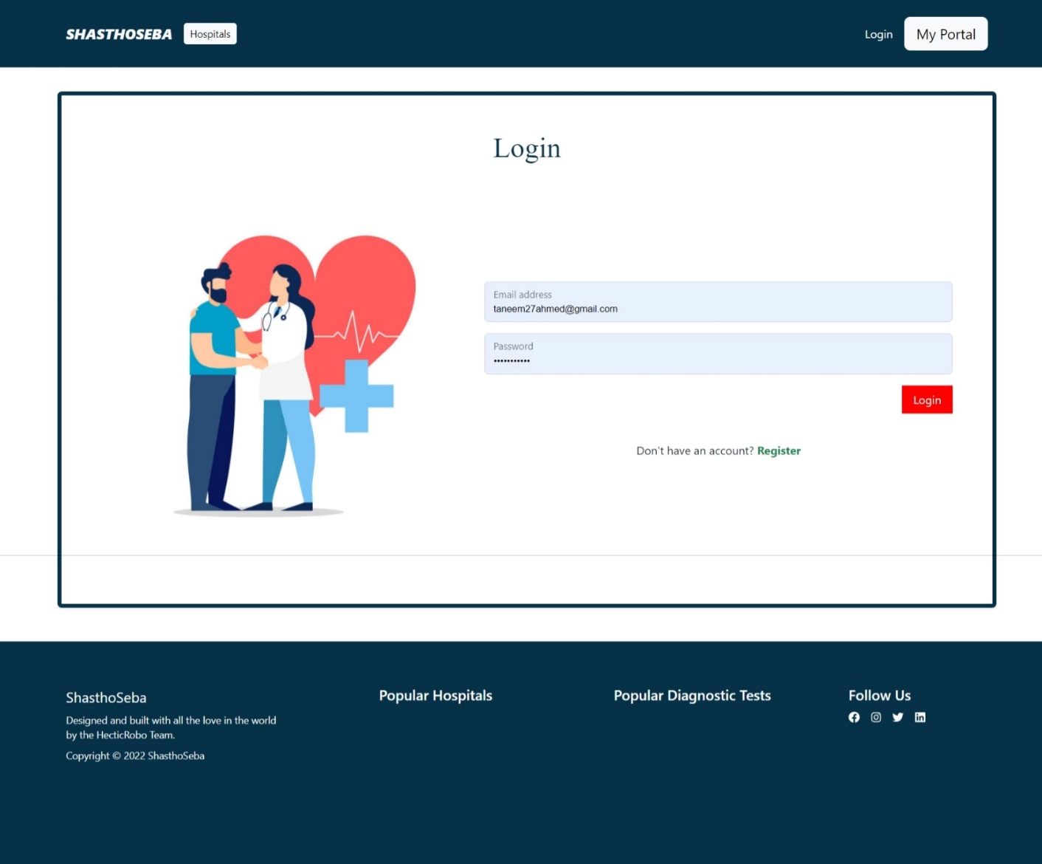
Functional Details

Slide 11
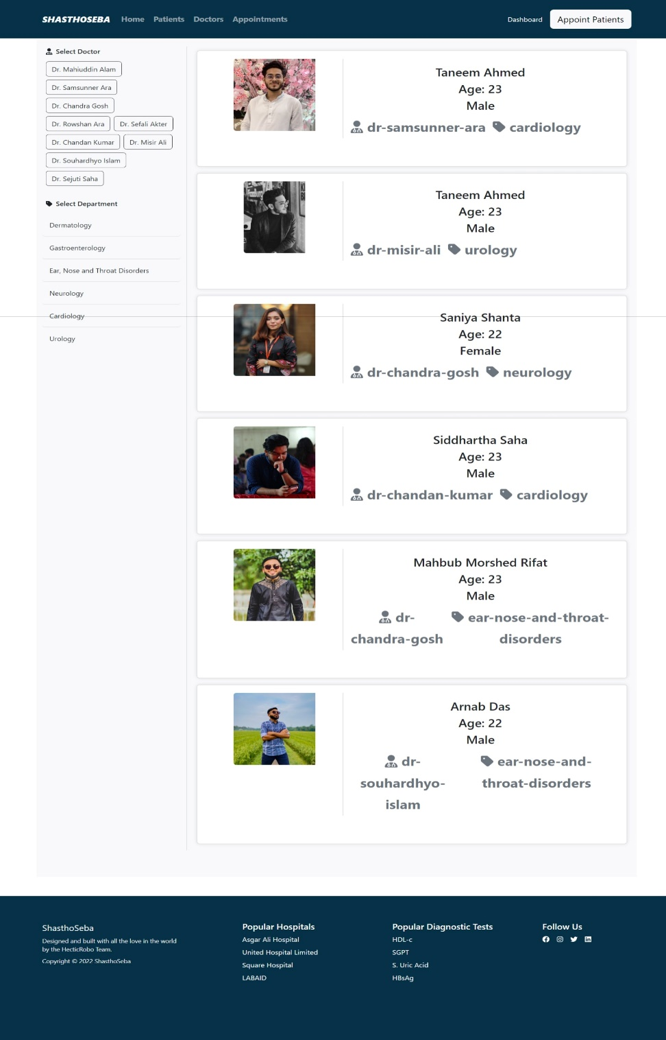
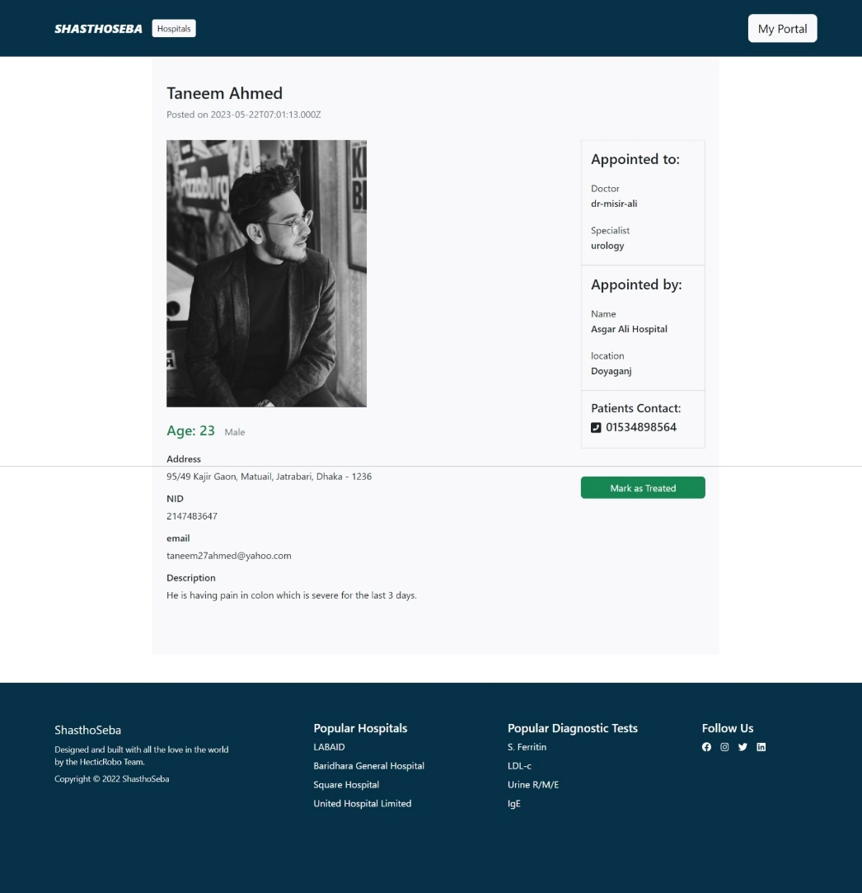
Functional Details

Slide 12

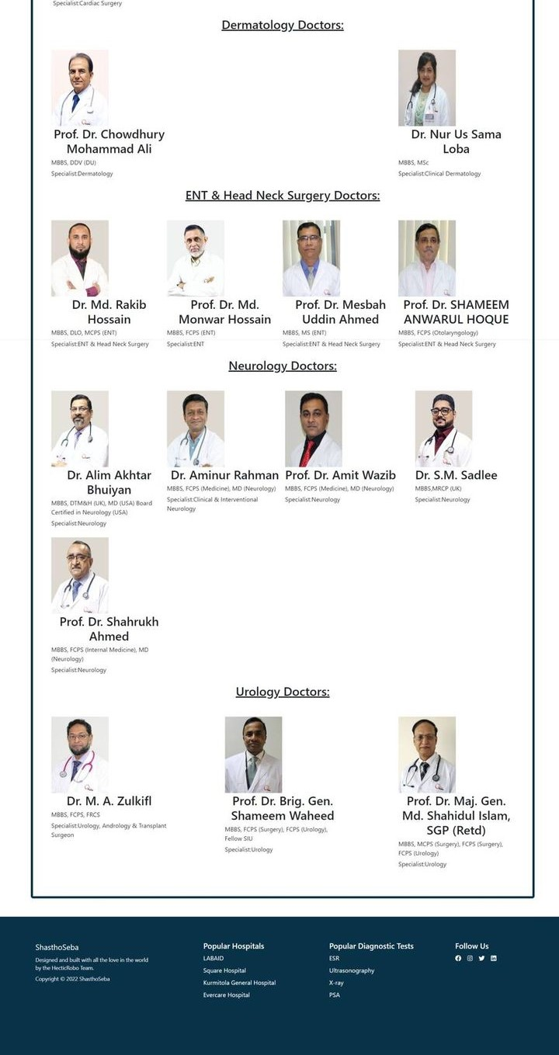
Special Feature
Different doctors from different hospitals use the same platform.

Slide 13
Technology Used And Methodology
React.js
MERN (a Node.js framework)
Express.js
Xampp MySQL
Postman
Database Management system: Xampp MySQL is used to store every data in the database
User interface development: React (also known as React.js) is a front-end JavaScript library that designs the front-end part.
Backend: Express is used to connect with the front end and the database.
API: Postman is an API platform for building and using APIs where we did our get and post requests

Slide 14
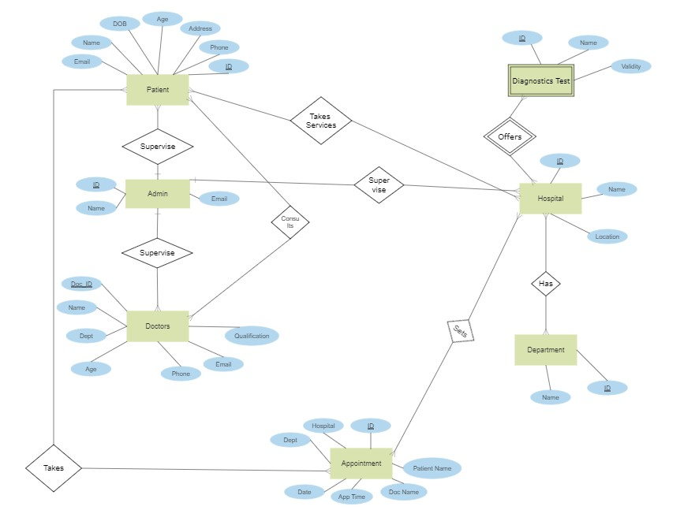
ER DIAGRAM

Slide 15
Not implemented feature
limitations
Scheduling: For hospitalized patients, when the doctor goes for a round to check patients.
Works with only registered doctors and hospitals, and patients.

Slide 16
Future enhancement
More features can be added. As a small system, it can be extensive, with thousands of hospitals registered, and lacs patients and doctors can use it.

Slide 17
What have we learned from the project?
Teamwork
Time management
New languages like Javascript, express Develop something new for the betterment of people.

Slide 18
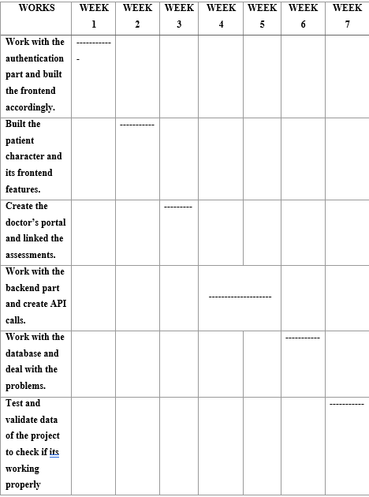
Week wise contribution of group members (7 weeks)

Slide 19
LET’S HAVE A DEMONSTRATION

Slide 20
Conclusion
Here’s SHASTHOSEBA for you where many features can be added, but we complete our prototype to design a centralized system and presented it.

Slide 21
THANK YOU

Slide 22
ANY QUESTIONS?

